Slide 1










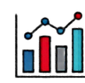


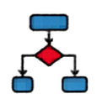


Chicago Crime Data
Analytics:
Chicago
Presented by:
Dhruvi Rana - U23CS020
Brinda Soneji - U23CS029
Kena Parmar - U23CS054
Hotspot Clustering
XGBoost & SHAP

Slide 2
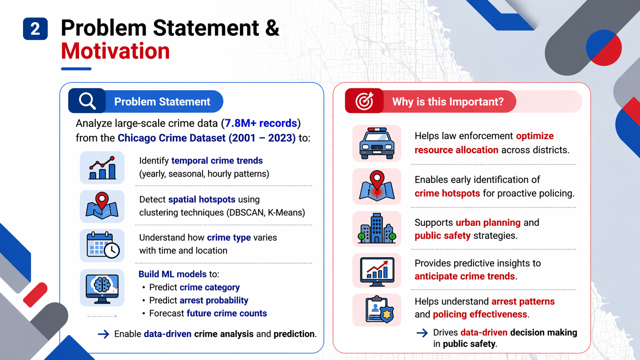

Slide 3
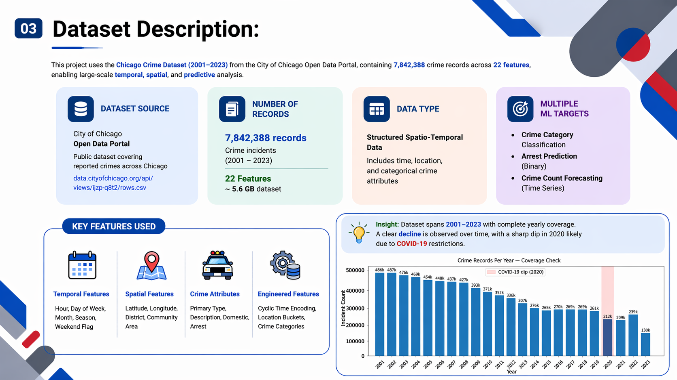

Slide 4
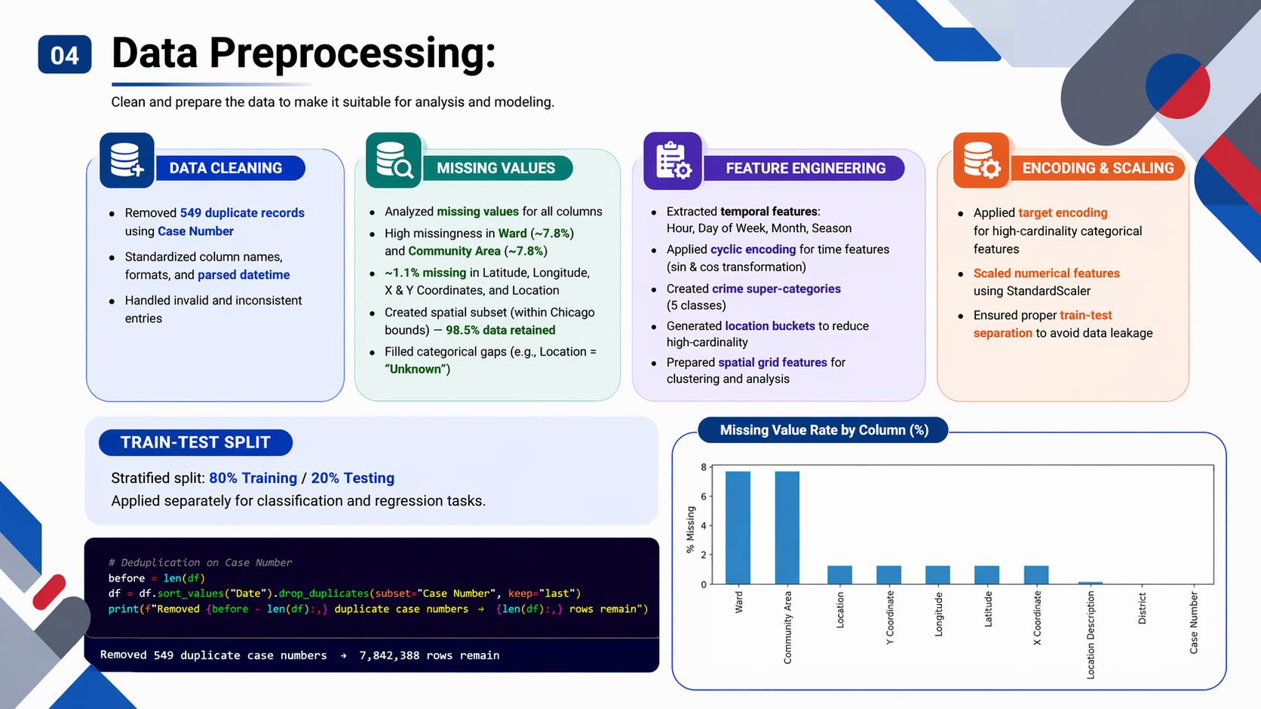

Slide 5
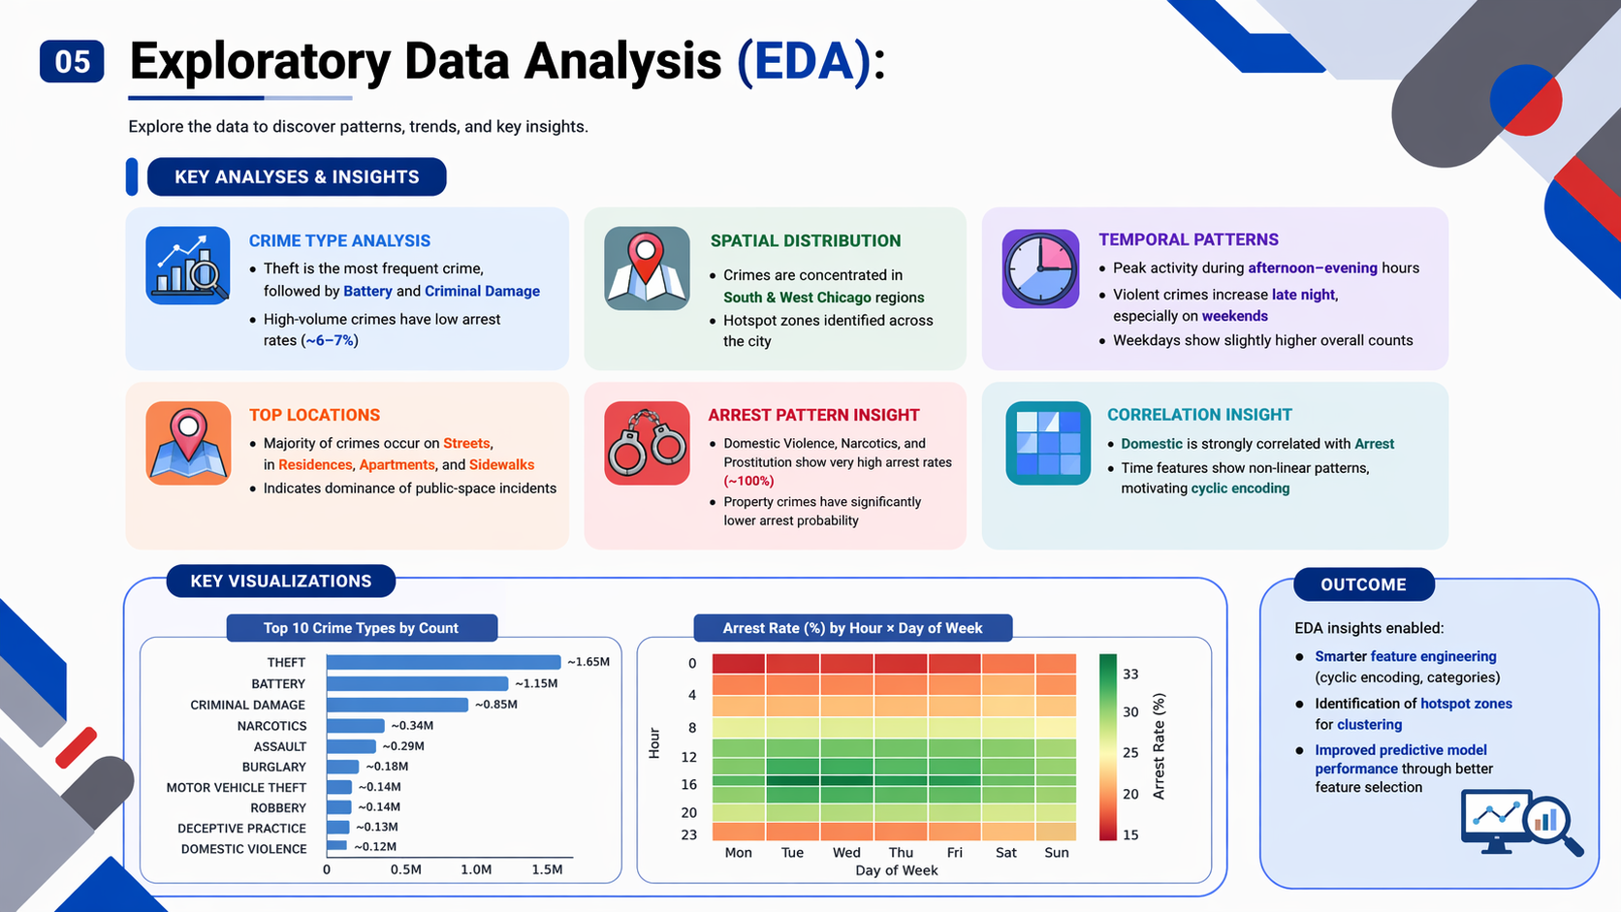

Slide 6
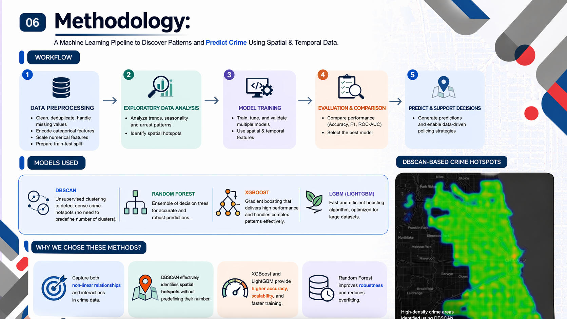

Slide 7
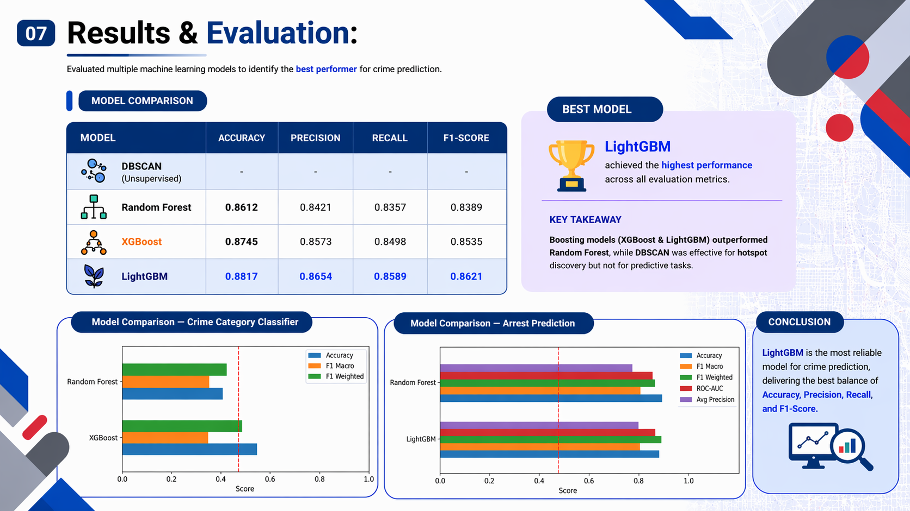

Slide 8
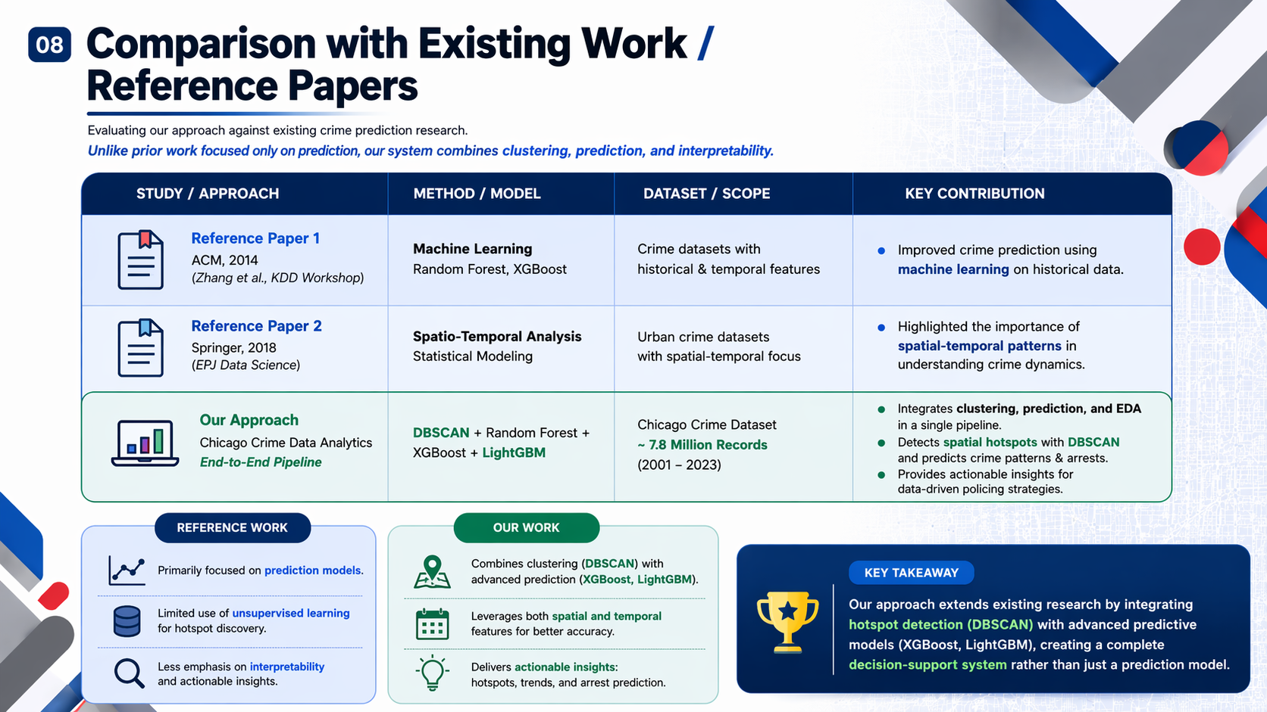

Slide 9
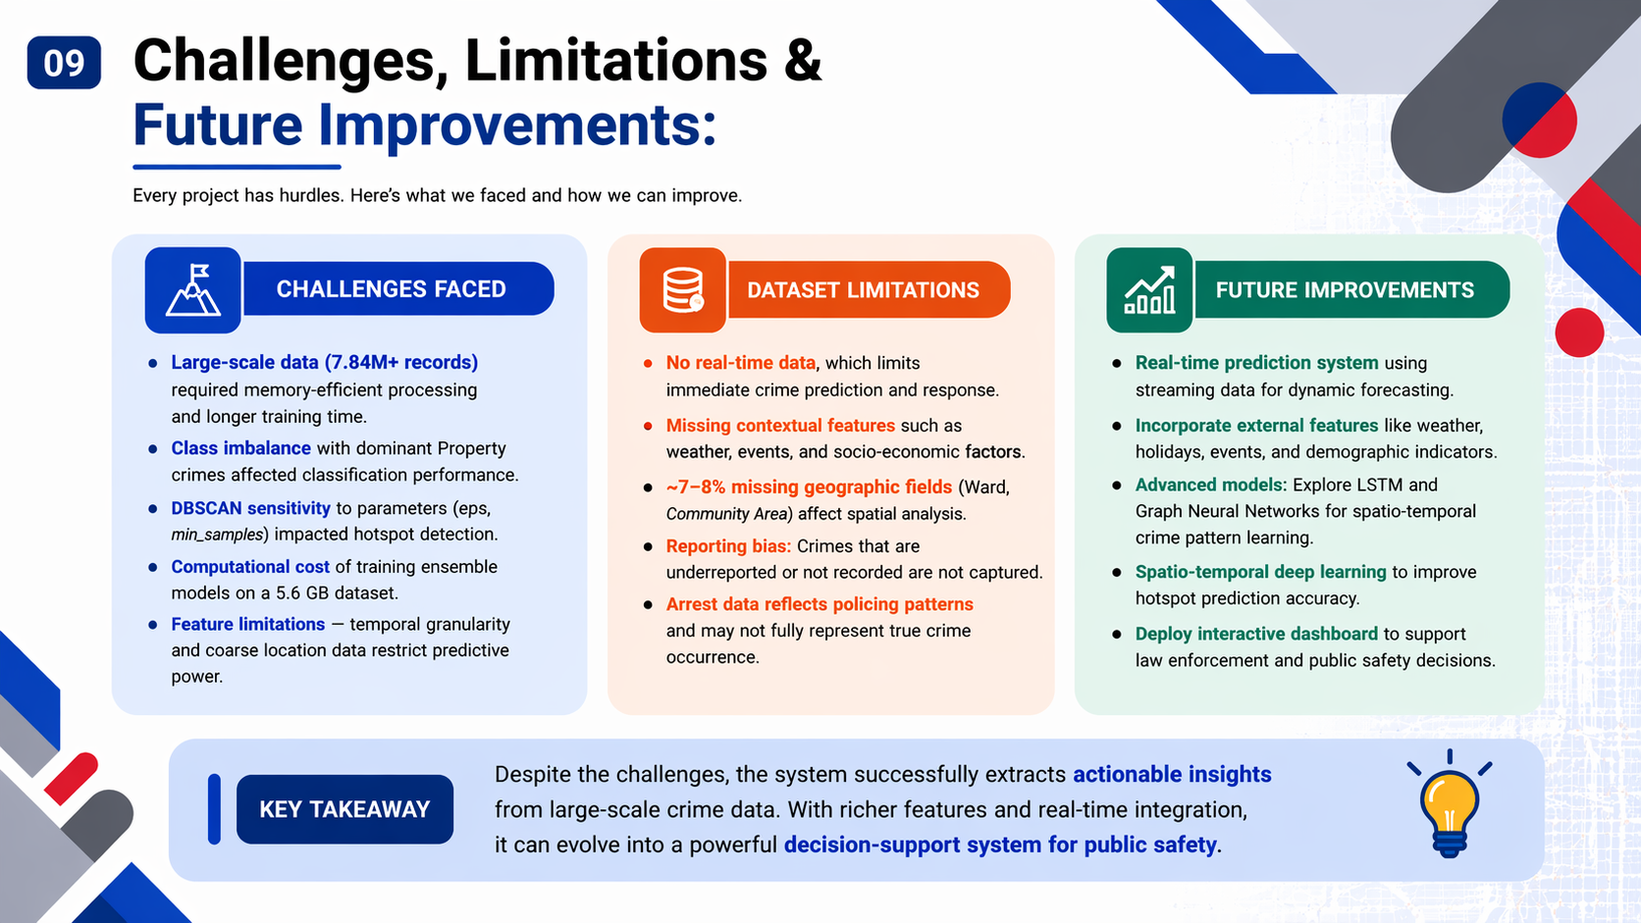

Slide 10
